Slide 1


Slide 2
Data Collection
In research, statisticians use data in many different ways.
Data can be used to describe situations.
Data can be collected in a variety of ways, BUT if the sample data is not collected in an appropriate way, the data may be so completely useless that no amount of statistical torturing can salvage them.

Slide 3
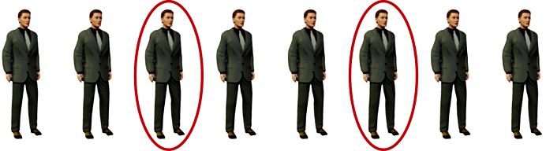
Basic Methods of Sampling
Systematic Sampling
  Select a random starting point and then select every k^{th} subject in the population
  Simple to use so it is used often

Slide 4
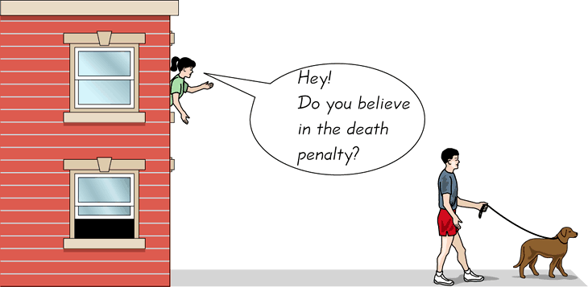
Basic Methods of Sampling
Convenience Sampling
  Use subjects that are easily accessible
  Examples:
    Using family members or students in a classroom
    Mall shoppers

Slide 5
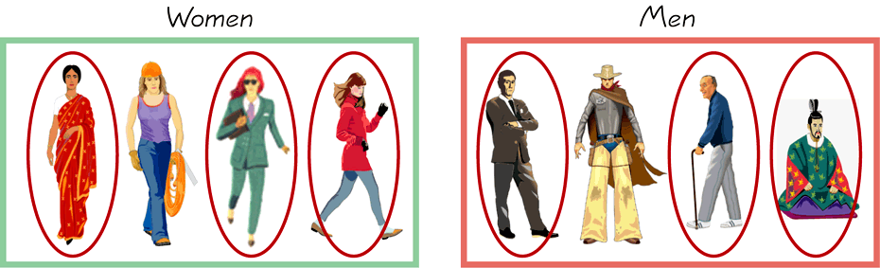
Basic Methods of Sampling
Stratified Sampling
  Divide the population into at least two different groups with common characteristic(s), then draw SOME subjects from each group (group is called strata or stratum)
  Results in a more representative sample

Slide 6
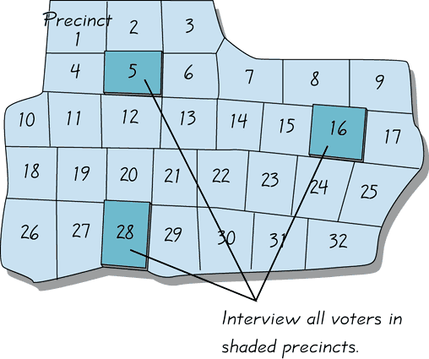
Basic Methods of Sampling
Cluster Sampling
  Divide the population into groups (called clusters), randomly select some of the groups, and then collect data from ALL members of the selected groups
  Used extensively by government and private research organizations
  Examples:
    Exit Polls

Slide 7
Sampling Plans…
A sampling plan is just a method or procedure for specifying how a sample will be taken from a population.
We will focus our attention on these three methods:
Simple Random Sampling,
Stratified Random Sampling, and
Cluster Sampling.
Random sampling,by far, is the most common one used.
5.<number>

Slide 8
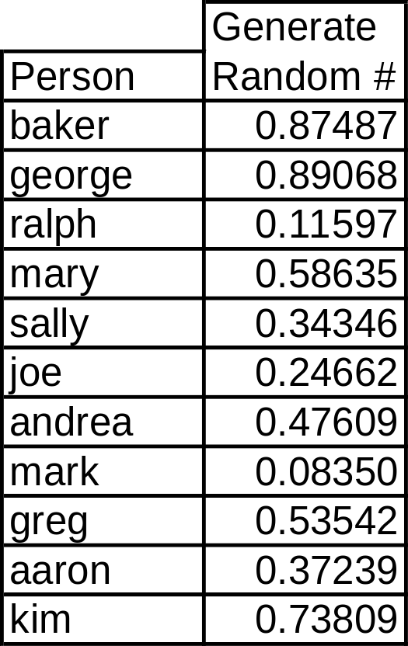
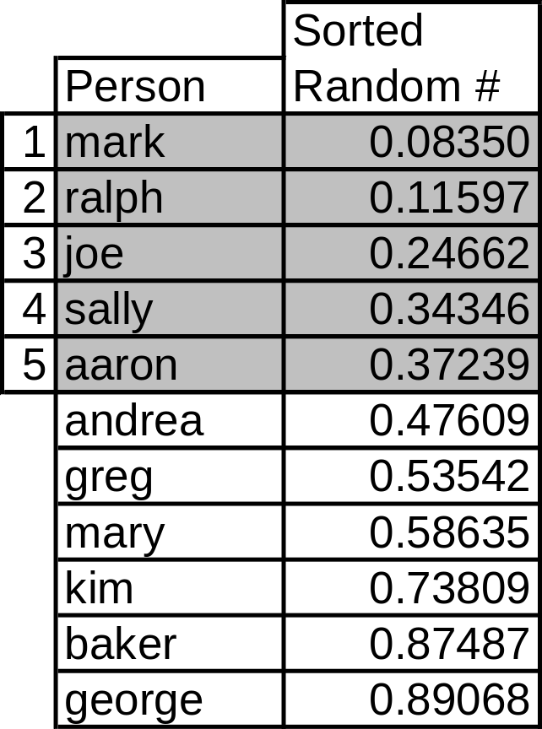
Simple Random Sampling…
A government income tax auditor must choose a sample of 5 of 11 returns to audit…[Can do many different ways]
5.<number>

Slide 9
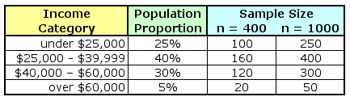
Stratified Random Sampling…
After the population has been stratified, we can use simple random sampling to generate the complete sample:
If we only have sufficient resources to sample 400 people total,
we would draw 100 of them from the low income group…
…if we are sampling 1000 people, we’d draw
50 of them from the high income group.
5.<number>

Slide 10
Cluster Sampling…
A cluster sample is a simple random sample of groups or clusters of elements (vs. a simple random sample of individual objects).
This method is useful when it is difficult or costly to develop a complete list of the population members or when the population elements are widely dispersed geographically. Used more in the “old days”.
Cluster sampling may increase sampling error due to similarities among cluster members.
5.<number>

Slide 11
Sample Size…
Numerical techniques for determining sample sizes will be described later, but suffice it to say that the larger the sample size is, the more accurate we can expect the sample estimates to be.
5.<number>

Slide 12
Sampling and Non-Sampling Errors…
Two major types of error can arise when a sample of observations is taken from a population:
sampling error and nonsampling error.
Sampling error refers to differences between the sample and the population that exist only because of the observations that happened to be selected for the sample. Random and we have no control over.
Nonsampling errors are more serious and are due to mistakes made in the acquisition of data or due to the sample observations being selected improperly. Most likely caused be poor planning, sloppy work, act of the Goddess of Statistics, etc.
5.<number>

